Slide 1

LANGUAGE PROCESSORS
Group No 14
Shyam Kawale [29]
Bhargav Pawar [50]
Nishant Bhat [43]
Abhijit Gawai [18]
Guided by Prof. Deepali Joshi
Computerhope.com

Slide 2
Contents
Introduction
Need Of Language
Types Of Language Processing
Language Processing Activities
Fundamental Of Language Processing
Example of Java Processor

Slide 3
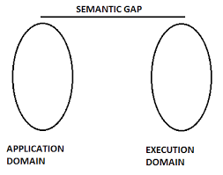
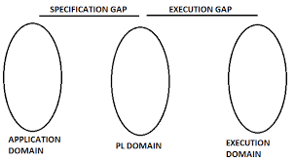
WHAT IS A LANGUAGE PROCESSOR?
Assembly language is machine dependent but the mnemonics are still not understood by the machine.
A language processor is a software program designed or used to perform tasks such as processing program codes to machine codes.
naveenkandwal.blogspot.com

Slide 4
NEED OF A LANGUAGE PROCESSOR?
“What do you mean by machine language?”
LD A, 8 ADD A, 5 This is Z80 assembler to add 8 and 5 together.
3E08C605 (This is a number in hexadecimal (base 16))
0011 1110 0000 1000 1100 0110 0000 0101
ADD AX, 3 This adds “3” to the value in the register AX.
At another point, you might write:
ADD [BX], AX (This adds the value in AX to the value at the memory location pointed to by BX.)

Slide 5
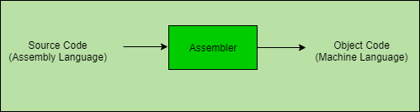
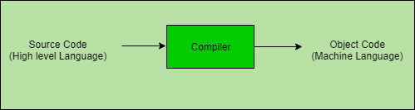
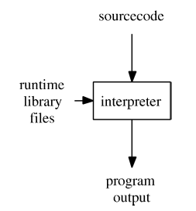
TYPES OF LANGUAGE PROCESSOR
Assembler
Compiler
Interpreter
geeksforgeeks.com

Slide 6
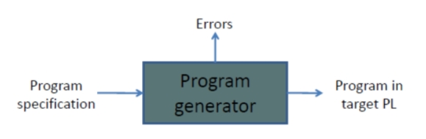
Language Processing Activities
We group fundamental language processing activities into two categories as
Program generation activities
Program Execution activities
Program generation activities
It aims at automatic generation of program.
The program generator is a software system which accepts the specification of a program and generates the program in target programming language
Reference:-https://learnspcc.blogspot.com/2020/07/sp-powerpoint-presentations-chapter-1.html

Slide 7
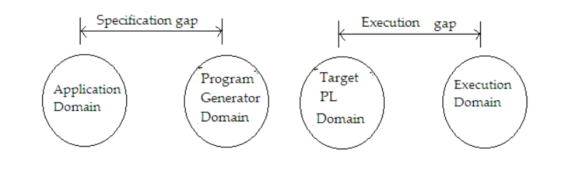
Advantages
Increase the reliability of the generated program, as generated domain is close to the application domain
It is easy for the designer to write the specification of the program to be generated.
Reference:-https://www.wikinote.org/mod/page/view.php?id=342

Slide 8
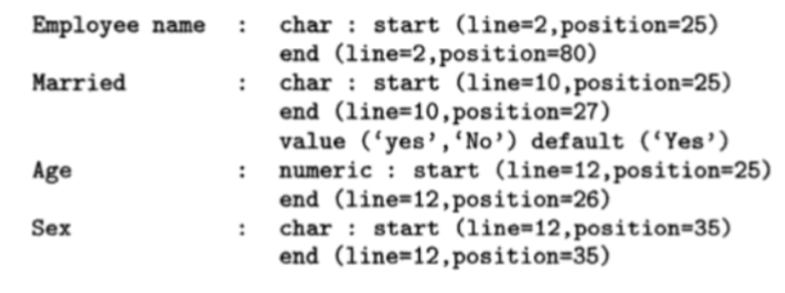
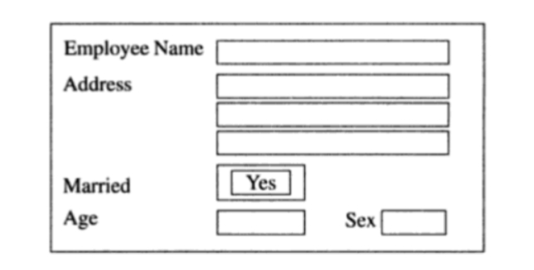
Example of specification
Reference:-https://learnspcc.blogspot.com/2020/07/sp-powerpoint-presentations-chapter-1.htm

Slide 9
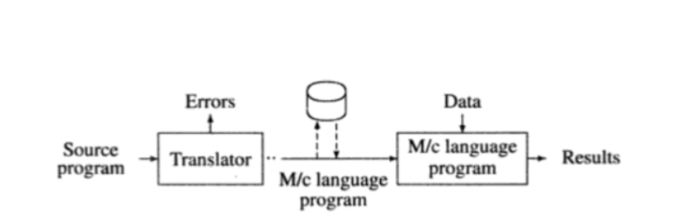
Program Execution activities
A program may be executed through :-
a) Program translation b) Progran interpretation.
Program translation
The program Translation model bridges the execution gap by translating a program written in programming language, called the source program in to equivalent program in the machine or assembly language of the computer system called the target program.
PROGRAM TRANSLATION MODEL
Reference:-https://d2s6cwygjqgm3u.cloudfront.net/course/4023/4022/material/11595.pdf

Slide 10
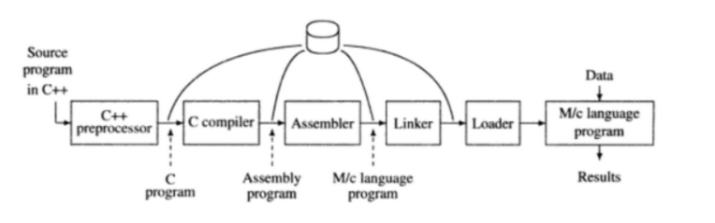
Characteristics of Program Translation Model
A program must be translated before it can be executed
A machine language program generated by translator is saved in file and loaded in main memory and executed whenever desired.
Retranslation required after modification in source program.
ARRANGEMENT OF ALL LANGUAGE PROCESSORS
Reference:-https://learnspcc.blogspot.com/2020/07/sp-powerpoint-presentations-chapter-1.html

Slide 11
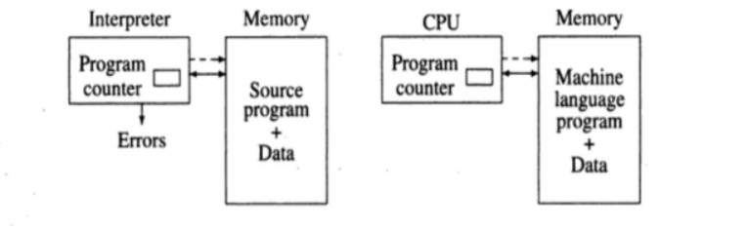
2. Program Interpretation
An interpreter executes a program without generating a target program.
Achieved in 3 different steps
Fetch the instruction
Decode the instruction
Perform the operation
Characteristics of program interpretation model
The source program is retained in the source form itself. A statement is analyzed during its interpretation.

Slide 12
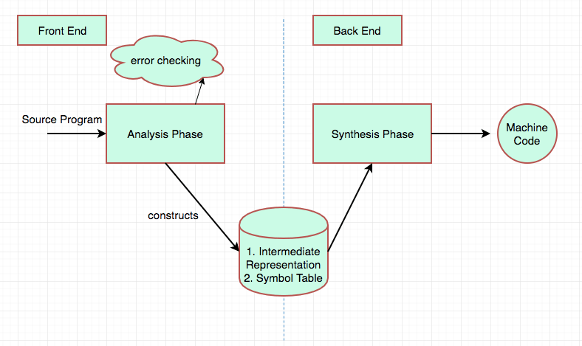
Fundamentals Of Language Processing
Fundamentals Of Language Processing = Analysis Of Source Program + Synthesis of Target Program
Reference: https://www.log2base2.com/compiler/basics/analysis-and-synthesis-phase-of-compiler.html

Slide 13
Language processing Phases
High Level Language
Lexical Analyzer
Syntax Analyzer
Semantic Analyzer
Error handler
Symbol Table
Memory Allocation
Code Optimizer
Analysis Phase
Target Code Generation
Synthesis Phase
Target Language

Slide 14
Specification Of Source language
Consists of three components:
Lexical Rules
Syntax Rules
Semantics Rules
For Example: x = a + b*c;
Lexical Units:
Identifies =,+,and * as operators,
Identifies any constants(ex: 75,100),
Identifies remaining String as Identifier.

Slide 15
Lexical Analysis
It converts src program into stream of tokens
Tokens contains two fields – Class code and No. in class.
Int x,a,b;
Double c;
X = a + b * c;
Id#1 | Op#7 | Id#2 | Op#7 | Id#3 | Op#6 | Id#5 | Op#10
 | Symbol | Type
1 | x | Int
2 | a | Int
3 | b | int
4 | c | double
5 | c* | int
6 | temp1 | int
7 | temp2 | int
Temp1 = b * (c*)
Temp2 = a + Temp1
Table: Symbol Table

Slide 16
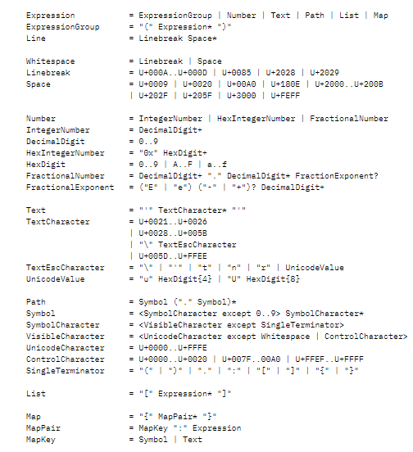
Regular Expression (Patterns)
Reference: Systems and Computers in Japan, Vol. 17, No. 12, 1986, “Fundamental concepts of language processor generator MYLANG” ,Hiroyuki Anzai , Takashi Yamanoue

Slide 17
Syntax Analysis (Parsing)
It processes stream of tokens and convert it into parse tree by determining class of statements.
It then builds Instruction Counter which represents the structure of statements
S → id = E;
E → E + T / T
T → T * F / F
F → id
X = a + b* c
Id#1 | Op#7 | Id#2 | Op#7 | Id#3 | Op#6 | Id#5 | Op#10
=
x
+
a
*
b
c*
Fig: Parse Tree

Slide 18
Semantic Analysis
It takes Parse tree and verify if it is meaningful or not.
Semantics help interpret symbols, their types, and their relations with each other.
CFG + semantic rules = Syntax Directed Definitions.
Tasks performed in semantic analysis:
Scope resolution
Type checking
Array-bound checking
=
x,int
+
a,int
*
b,int
c*,int
Fig: Semantically verified Parse Tree

Slide 19
Memory Allocation
First step of Synthesis Phase.
The memory requirement of identifier is computed from its type, length and dimensionality.
The address of memory area is entered in Symbol Table.
 | Symbol | Type | address
1 | x | Int | 2000
2 | a | Int | 2002
3 | b | int | 2004
4 | c | double | 2006

Slide 20
Code Optimization
Optimization is a program transformation technique.
Improve s code by making it consume less resources (i.e. CPU, Memory) and deliver high speed.
A code optimizing process must follow the three rules given below:
The output code must not change the meaning of the program.
Optimization should increase the speed of the program.
Optimization should itself be fast and should not delay the overall compiling process.

Slide 21
Code Generation
Final phase of compilation.
The code generator should take the following things into consideration to generate the code:
Target language
IR Type
Selection of instruction
Register allocation
Ordering of instructions

Slide 22
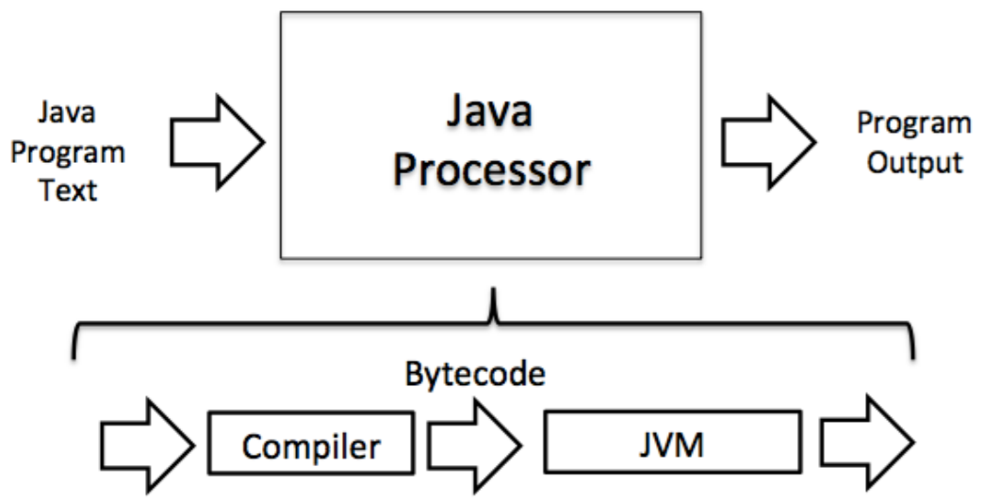
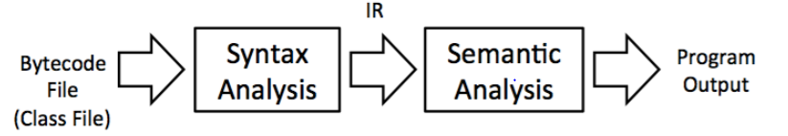
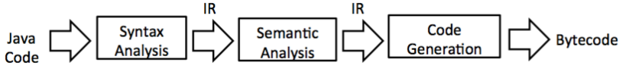
An Example: Processing the Java Language
Think of a Java processor in terms of a pipeline of multiple smaller processors
Java processing pipeline
Java virtual machine
Java compiler architecture
https://homepage.cs.uri.edu/faculty/hamel/langbook/chap01.pdf

Slide 23
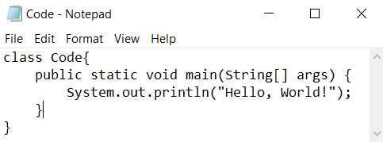
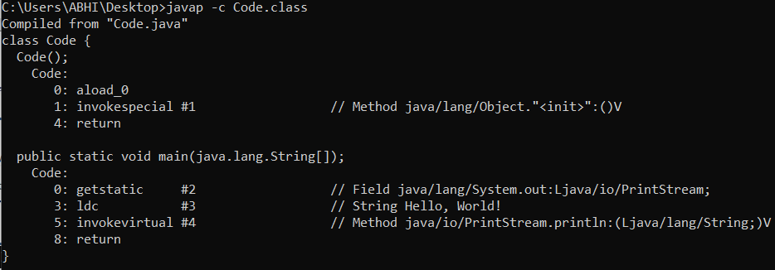

Program
Compile
(Java Compiler)
ByteCode
Interpret
(Java Virtual Machine)
Output

Slide 24
References
[1] https://learnspcc.blogspot.com/2020/07/sp-powerpoint-presentations-chapter-1.html
[2] naveenkandwal.blogspot.com
[3] geeksforgeeks.com
[4] https://www.wikinote.org/mod/page/view.php?id=342
[5] https://learnspcc.blogspot.com/2020/07/sp-powerpoint-presentations-chapter-1.html
[6] https://d2s6cwygjqgm3u.cloudfront.net/course/4023/4022/material/11595.pdf
[7] https://www.log2base2.com/compiler/basics/analysis-and-synthesis-phase-of-compiler.html
[8] Systems and Computers in Japan, Vol. 17, No. 12, 1986, “Fundamental concepts of language processor generator MYLANG” ,Hiroyuki Anzai , Takashi Yamanoue
[9] https://homepage.cs.uri.edu/faculty/hamel/langbook/chap01.pdf

